Slide 1
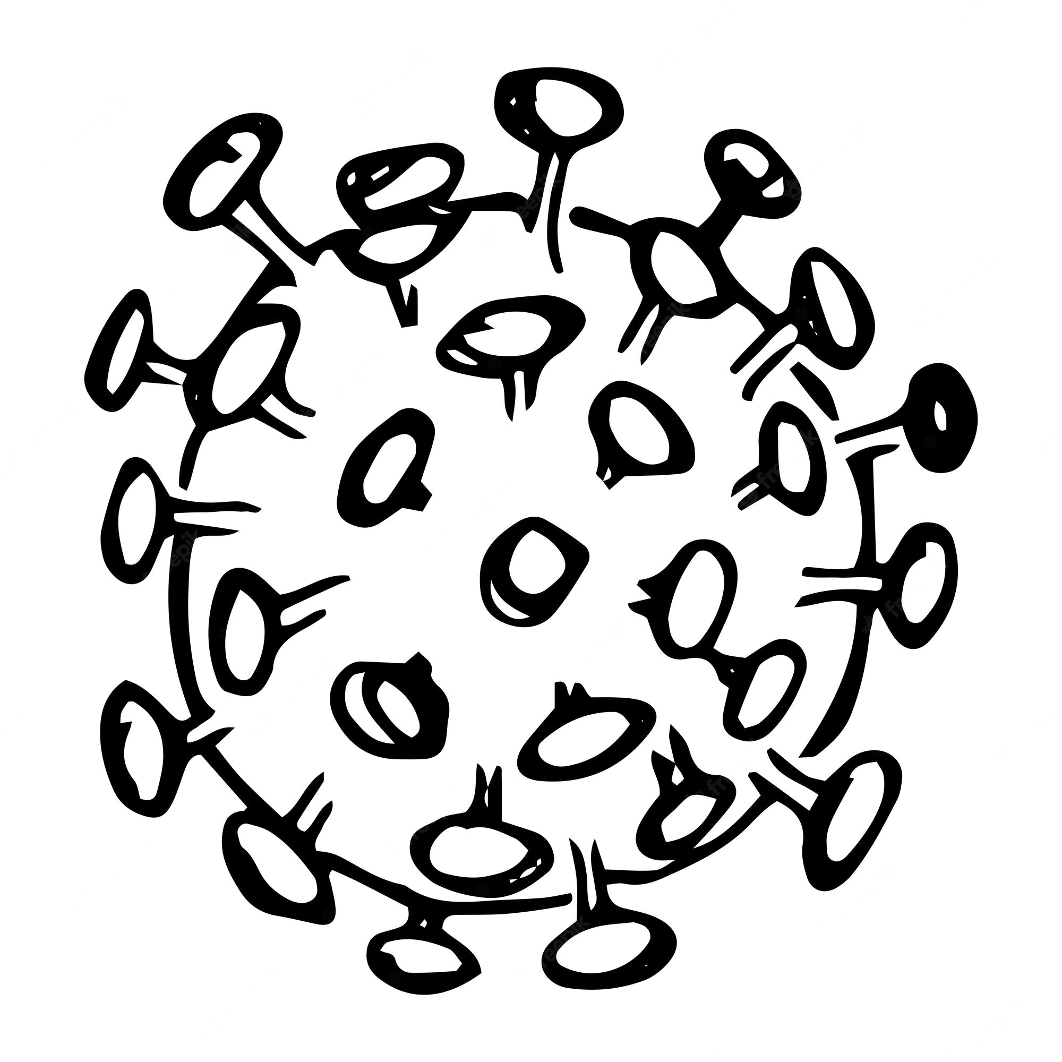
Seasonal flu vaccination
Kit N., Lucas F. and Navpreet N.

Slide 2

Project proposal
Our project aims to predict whether individuals will receive their seasonal flu vaccine
US National 2009 H1N1 flu survey data is explored to study the vaccination pattern
We fit a machine learning model with random forest classifier to the vaccination data
Model is tuned using the following techniques:
Feature selection to reduce number of input features
Hyperparameter tuning with RandomizedSearchCV
Hyperparameter tuning with GridSearchCV
Second machine learning model using deep learning is also considered
Performance of each model is analysed and compared. Accuracy is the focused metric.

Slide 3

The dataset
We use the U.S National 2009 H1N1 flu survey (NFHS) data. This dataset is a copy shared by the U.S National Centre for Health Statistics for a data science competition hosted by DrivenData.
The NFHS data contains 26,707 survey respondents. Each survey respondents were asked whether they have received the H1N1 and seasonal flu vaccines and additional questions about themselves such as social, economic and demographic background, opinion and risks of illness and vaccine effectiveness, and behaviour towards mitigating transmission.

Slide 4
Data checking and cleaning
Class balance – Our target variable has balanced classes.
Missing values (Recall that our data has c.30 features) Observation: - 3 feature columns have more than 40% missing value. These features are excluded from our modelling. - the proportion of missing values observed in other features ranges between 0% - 17%.
Strategy for replacing missing values: - We replace missing value with the most_frequent value observed using sklearn.impute.SimpleImputer module. This works well for both numerical and categorical variables.
DATA TYPES - Dataset has both numerical and categorical variables. Categorical variables are encoded into numerical values using sklearn.preprocessing.OneHotEncoder.

Slide 5
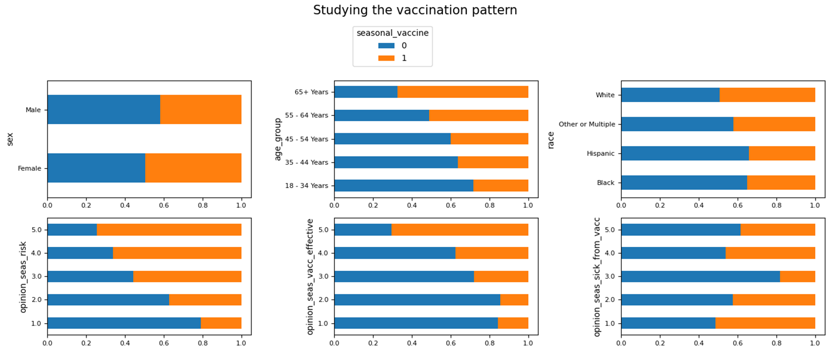
Exploring the data
Explore how the features are correlated with the target variable. If a feature is correlated with target, we expect to see different vaccination pattern as the values of the feature vary.

Slide 6
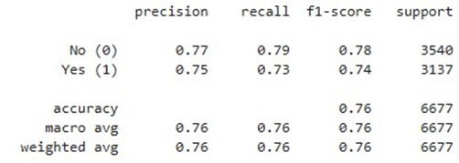
Establish baseline model
Random forest model chosen as baseline due to high accuracy and ability to handle large, complex datasets
Robust to overfitting, ensuring good generalization performance on new data
Simple to implement and require little fine-tuning

Slide 7
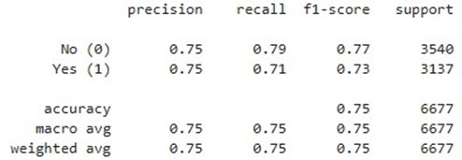
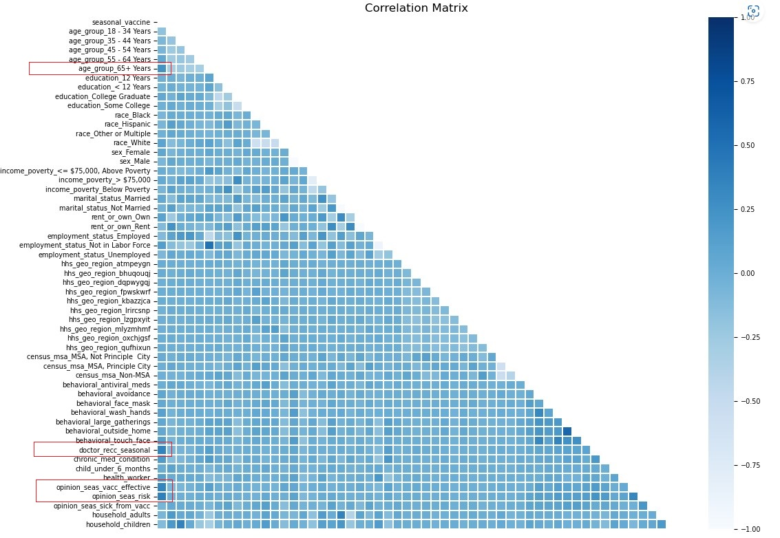
Tuning model: features selection
Correlation matrix used to select top 4 features with highest correlation to target variable
New model with reduced features had slightly lower accuracy (74.5%), but was simpler and faster to train and predict
Additional features may be correlated with other features or irrelevant to target variable

Slide 8
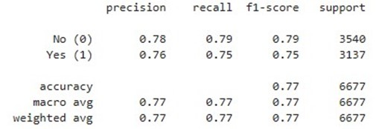
Tuning model: randomizedSearchcv
20 models trained over 2 folds of cross-validation (40 total)
Best fit selected based on accuracy
Best hyperparameters: n_estimators = 207, max_features = 10, min_samples_split = 23
Resulting accuracy score: 77.18%, an improvement on baseline model

Slide 9
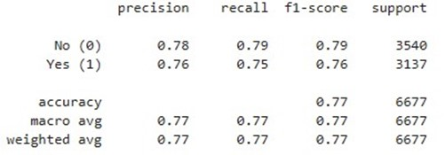
Tuning model: gridSearchcv
Algorithm trains and evaluates model for every combination of values in specified hyperparameter grid
Model with highest mean score across cross-validation folds is selected as best model, with best combination of hyperparameters retained
Guaranteed to find optimal combination of hyperparameters
Resource intensive as examines all combinations
Final accuracy score: 77.28%, an improvement on baseline model

Slide 10
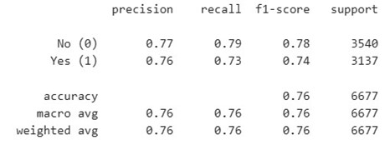
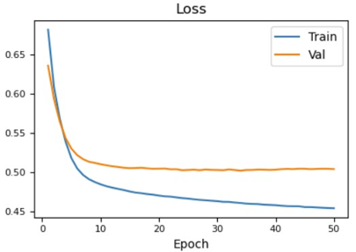
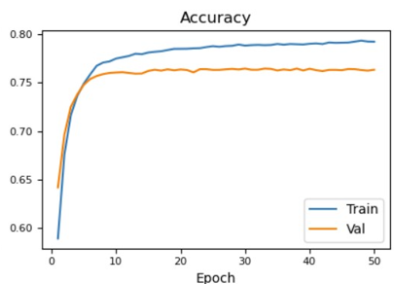
Deep Learning Using Neural Networks
Binary classification using a neural network. The neural network is:
Two-layer deep that uses “relu” activation function on both layers
Compiled using the “binary_crossentropy” loss function, the “adam” optimiser and the “accuracy” evaluation metrics.
Fitted using 50 epochs and 1000 batch size.
This model has an accuracy score of 76.43%, slightly higher than baseline.

Slide 11
Deep Learning Using Neural Networks
Parameters to Manipulate:
Optimizer
Epochs
Number of Hidden Layers
(Hidden Layer Parameters):
Number of Hidden Nodes per Layer
Activation Function
Dropout Rate (Regularization Technique)
Activation Function for Output Layer

Slide 12
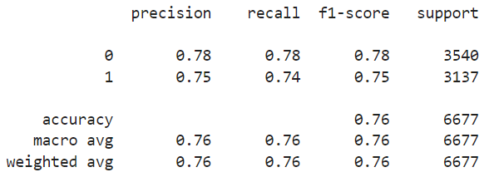
Deep Learning Using Neural Networks
Layer 1
Hidden Nodes: 27
Activation Function: Sigmoid
Dropout Rate: 0.5
Layer 2
Hidden Nodes: 14
Activation Function: Sigmoid
Dropout Rate: 0.2
> Tuning | What worked best
Input Features: 54
Output Neurons: 1
Loss: Binary Cross-Entropy
Optimizer: Stochastic Gradient Decent
Metrics: Accuracy
Epochs: 150
Layer 3
Hidden Nodes: 7
Activation Function: Sigmoid
Dropout Rate: 0.2
Layer 4
Hidden Nodes: 4
Activation Function: Sigmoid
Accuracy: 76.28%
SLIGHTY LOWER than baseline DLM (76.43%)
Output Layer
Activation Function: Sigmoid

Slide 13
evaluation
Model | Accuracy
Baseline | 76.13%
Features Selection | 75.15%
RandomizedSearchCV | 77.18%
GridSearchCV | 77.28%
Deep Learning Model | 76.43%
Tuned Deep Learning Model | 76.28%
Hyperparameter tuning using gridsearchcv resulted in highest accuracy score (77.28%) but resource heavy
Randomizedsearchcv improved accuracy efficiently
Limiting number of features resulted in slightly lower accuracy, but simpler and faster model
Opportunity to further Fine tuning THE deep learning model through changing hyperparameters

Slide 14

Future work
New combinations
Try different model configurations or algorithms
Train the model with different feature subsets
Evaluation metrics
Evaluate models using additional performance metrics, e.g., precision and recall F1 Score to get a more comprehensive understanding of the model performance.
Fine tuning
Explore hyperparameter tuning on the neural network model.

Slide 15

Thank you
Kit N., Lucas F. and Navpreet n.

